Slide 1
Summer Squash AQ 7083 (XD2104) Green Zucchini Bulby
Amerland Seeds
Woodland, CA

Slide 2
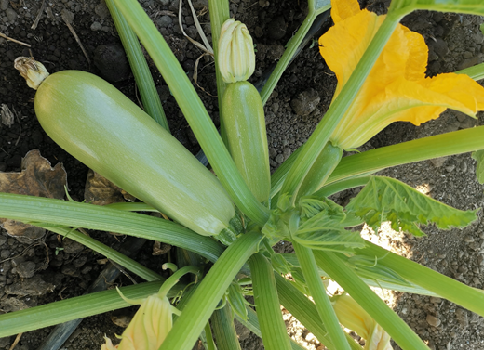
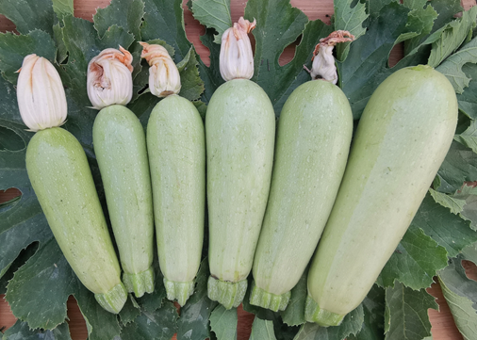
Summer Squash AS7083 Bulby
Maturity | Plant vigor | Plant type | Openness | Spines | Fruit shape | Fruit color | Disease R/T | Remarks | Status
Early | Strong | Semi-elected | Open | Moderate | Long bulby | Light green | N/A | Strong semi-elected plant, excellent setting, very high yield, uniform shinny fruits with no spots. For GH and open fields. | Commercial

Slide 3
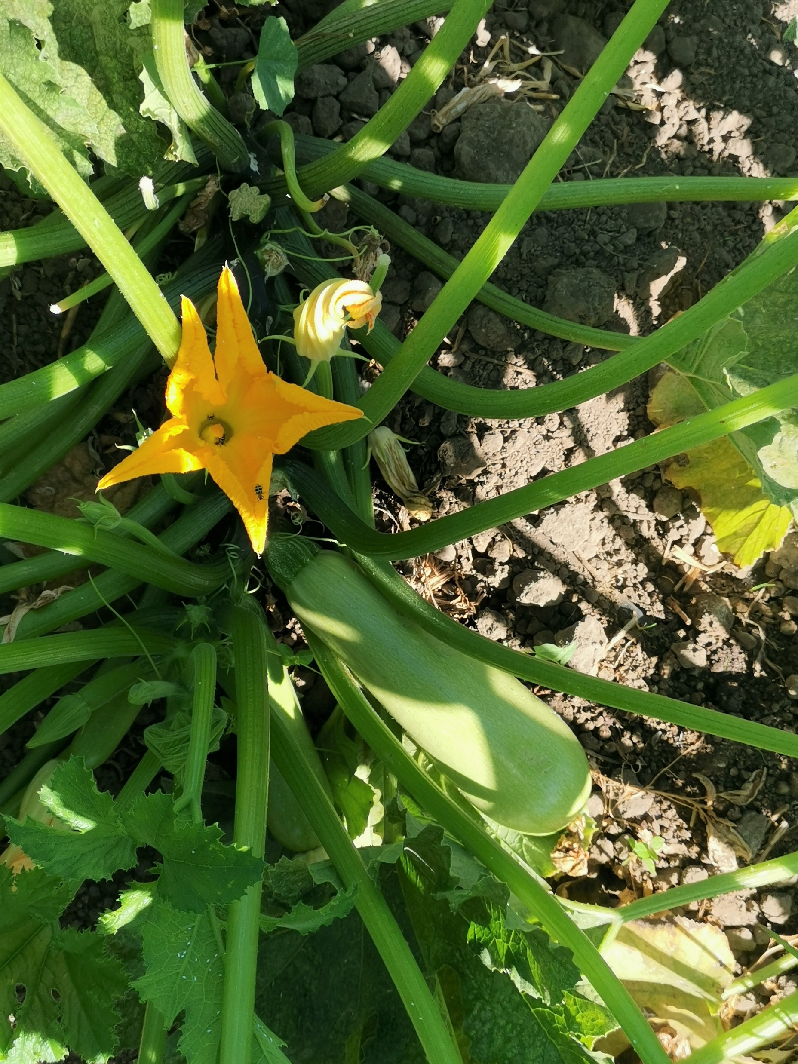
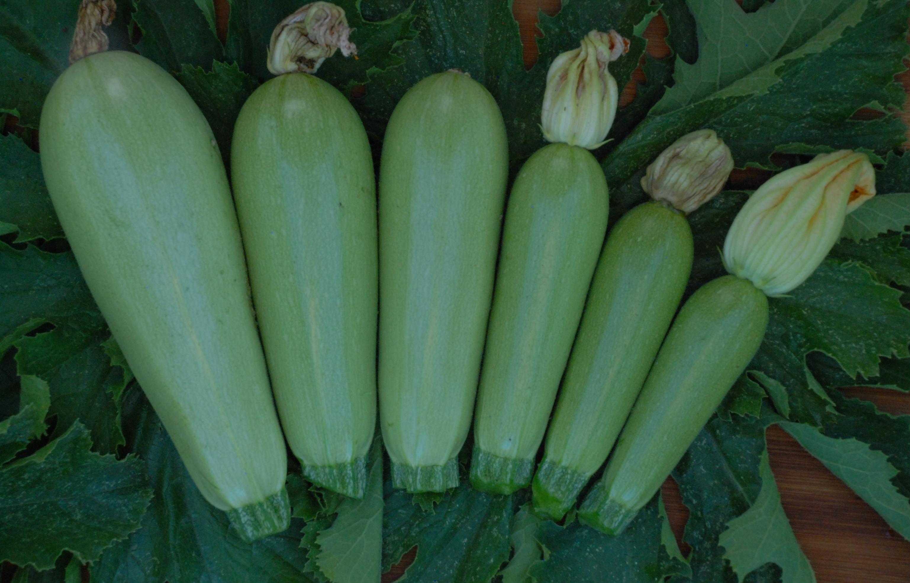
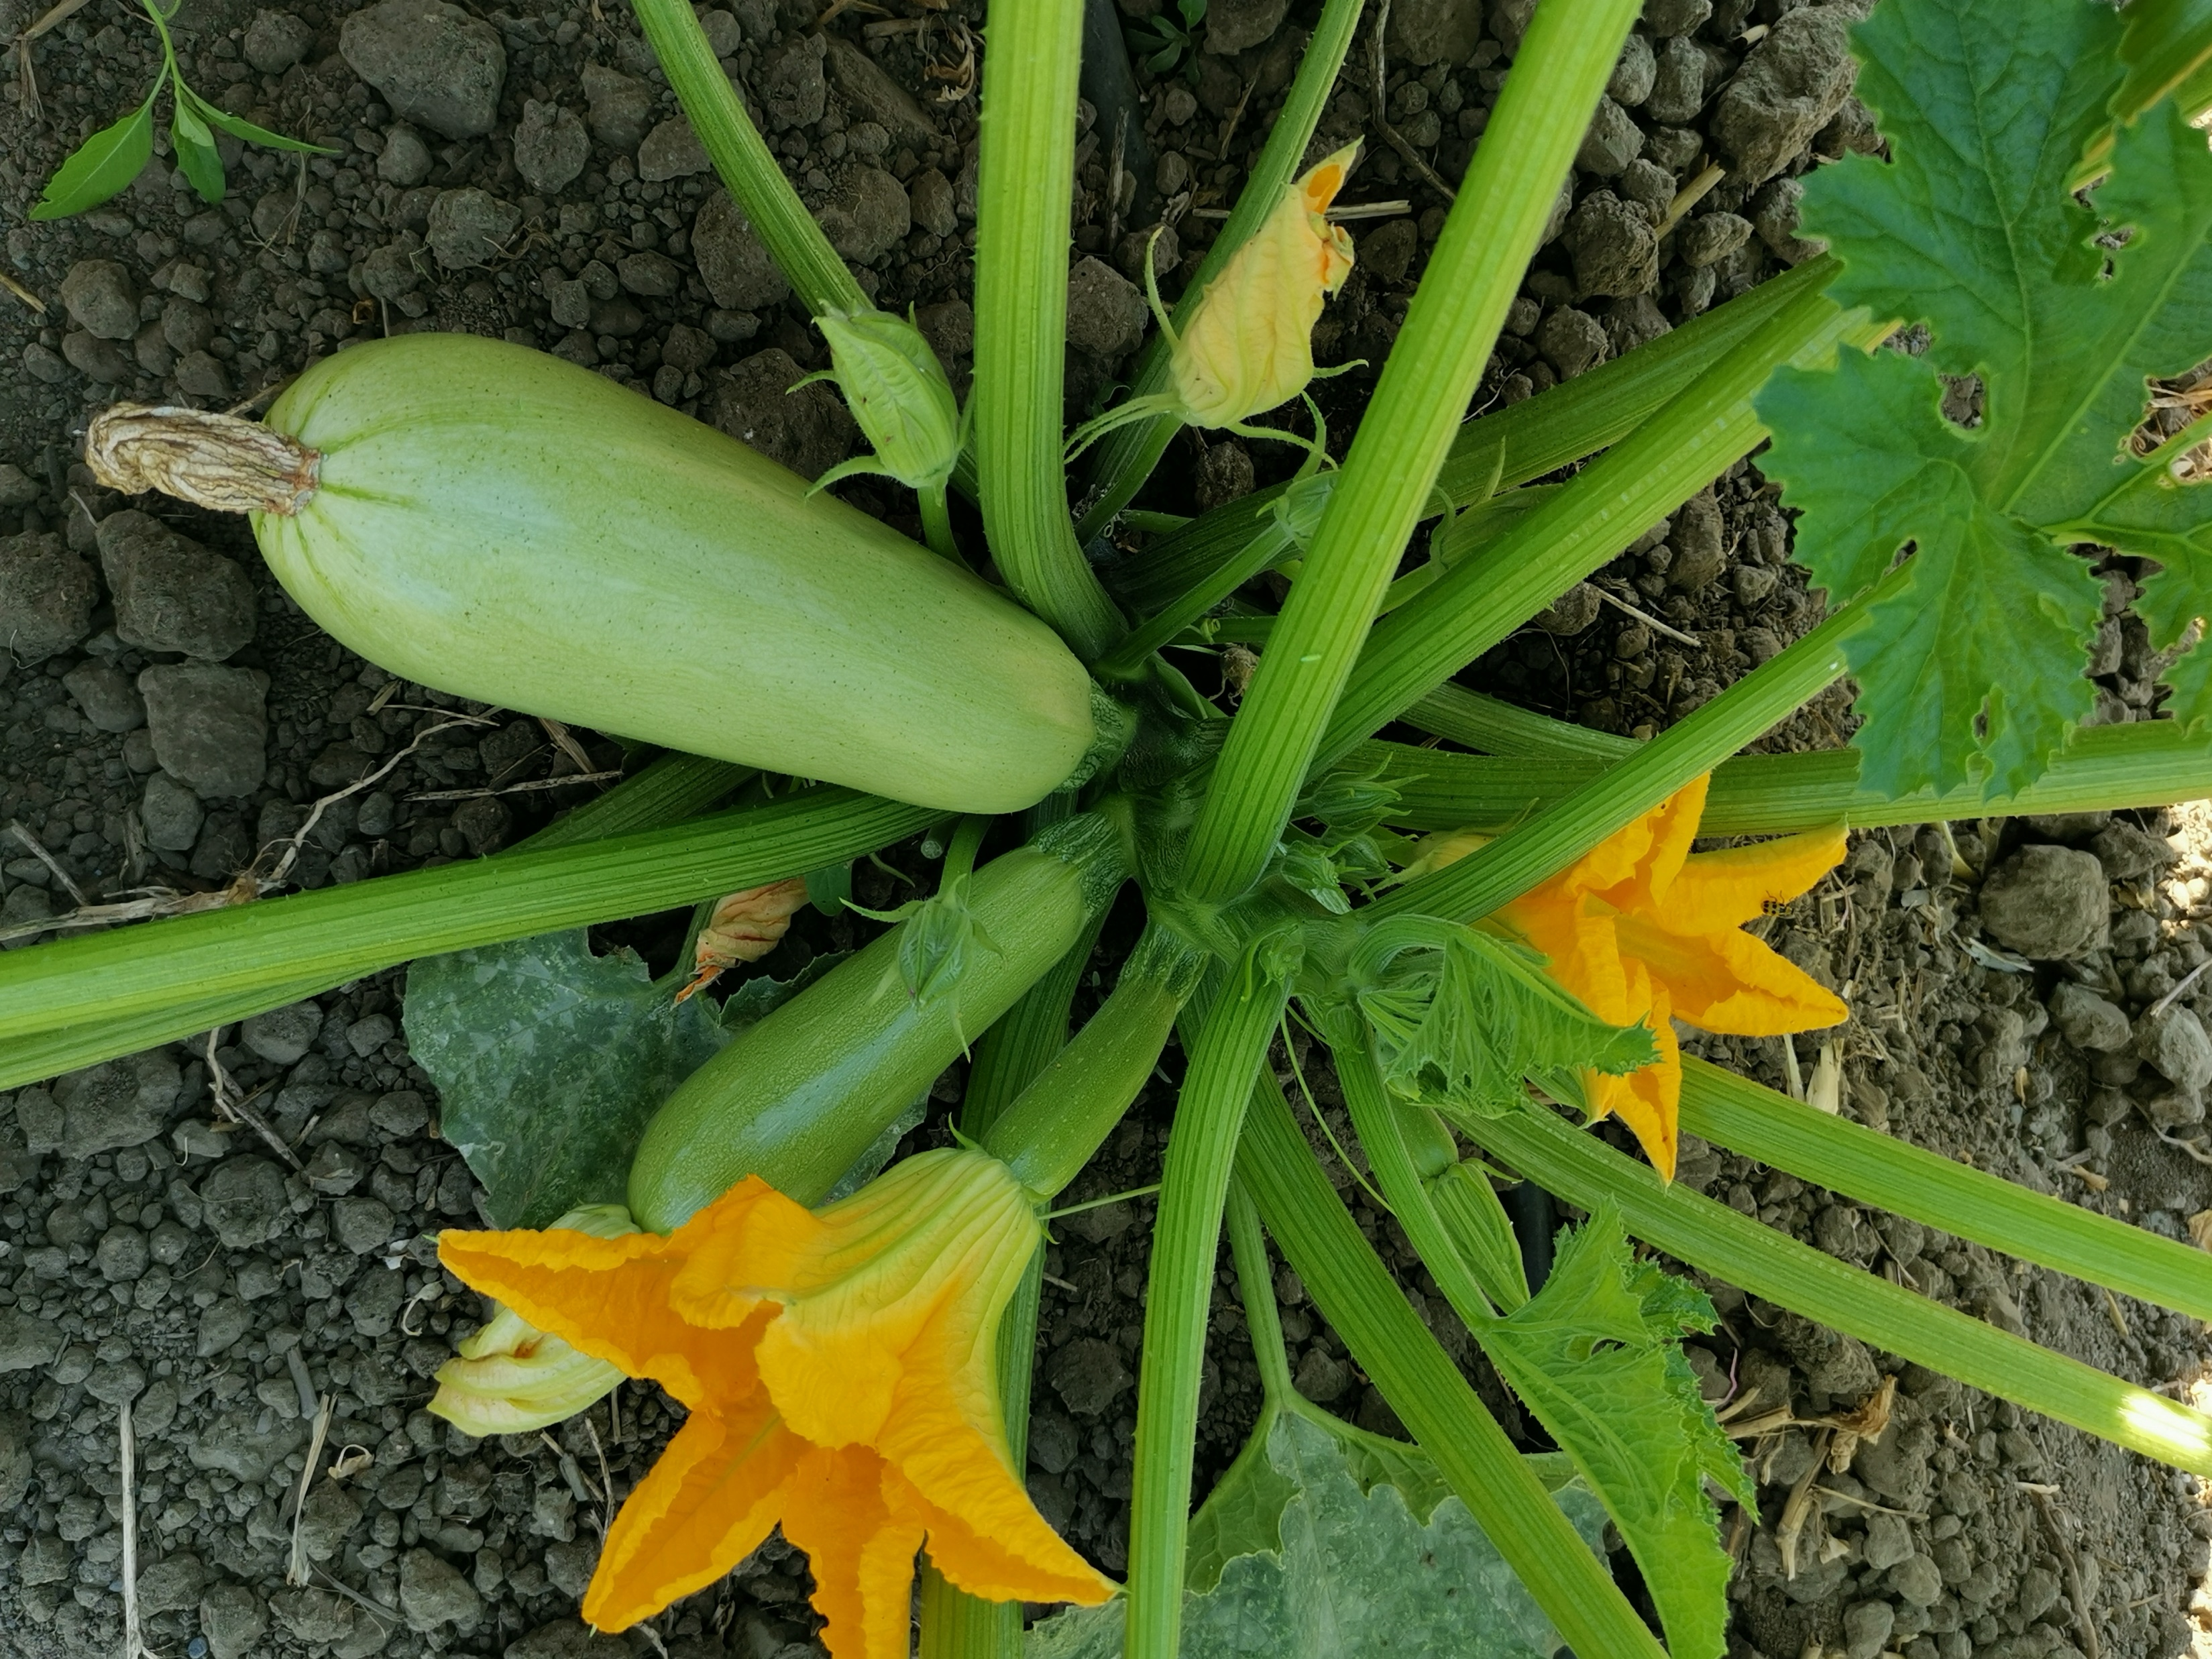
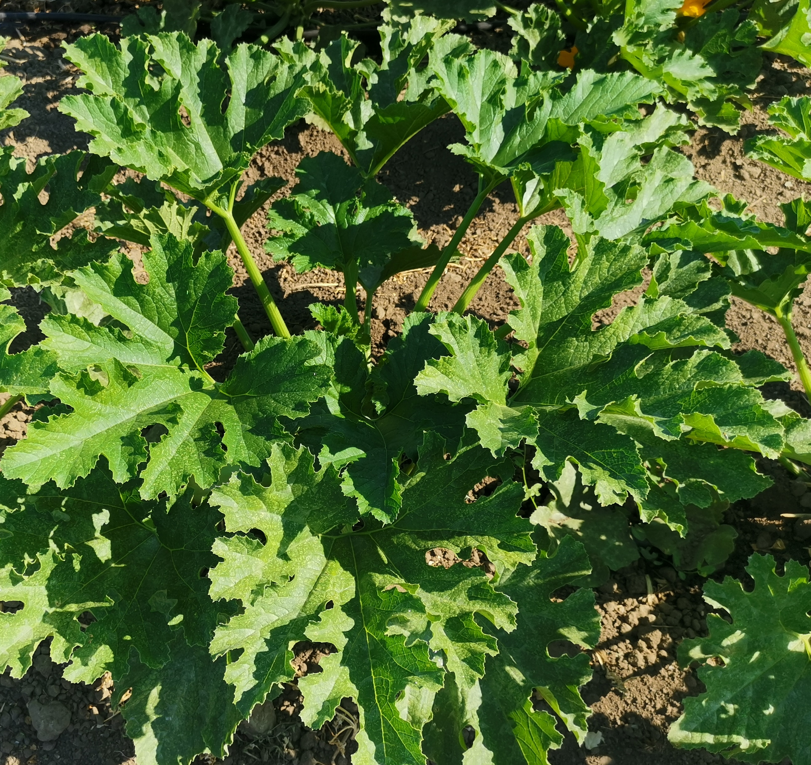
2020 #628=AS7083=XQ2104 (XD) LC
Stake# | Variety | Source | Original | Vigor | L color | Opening | Thorn | Stem | Internode | Virus R | Setting B/L | F color | Shape | F/P | Description | Decision FINAL
628 | AS7083 | XD | XQ2104 | 5 | DG | Patial open | NO | Semi-creeping | S | HR | /5 | Green | Long bulby | 12.3 | 早熟/植株非常好/果好/高产/非常抗病 | Commercial

Slide 4
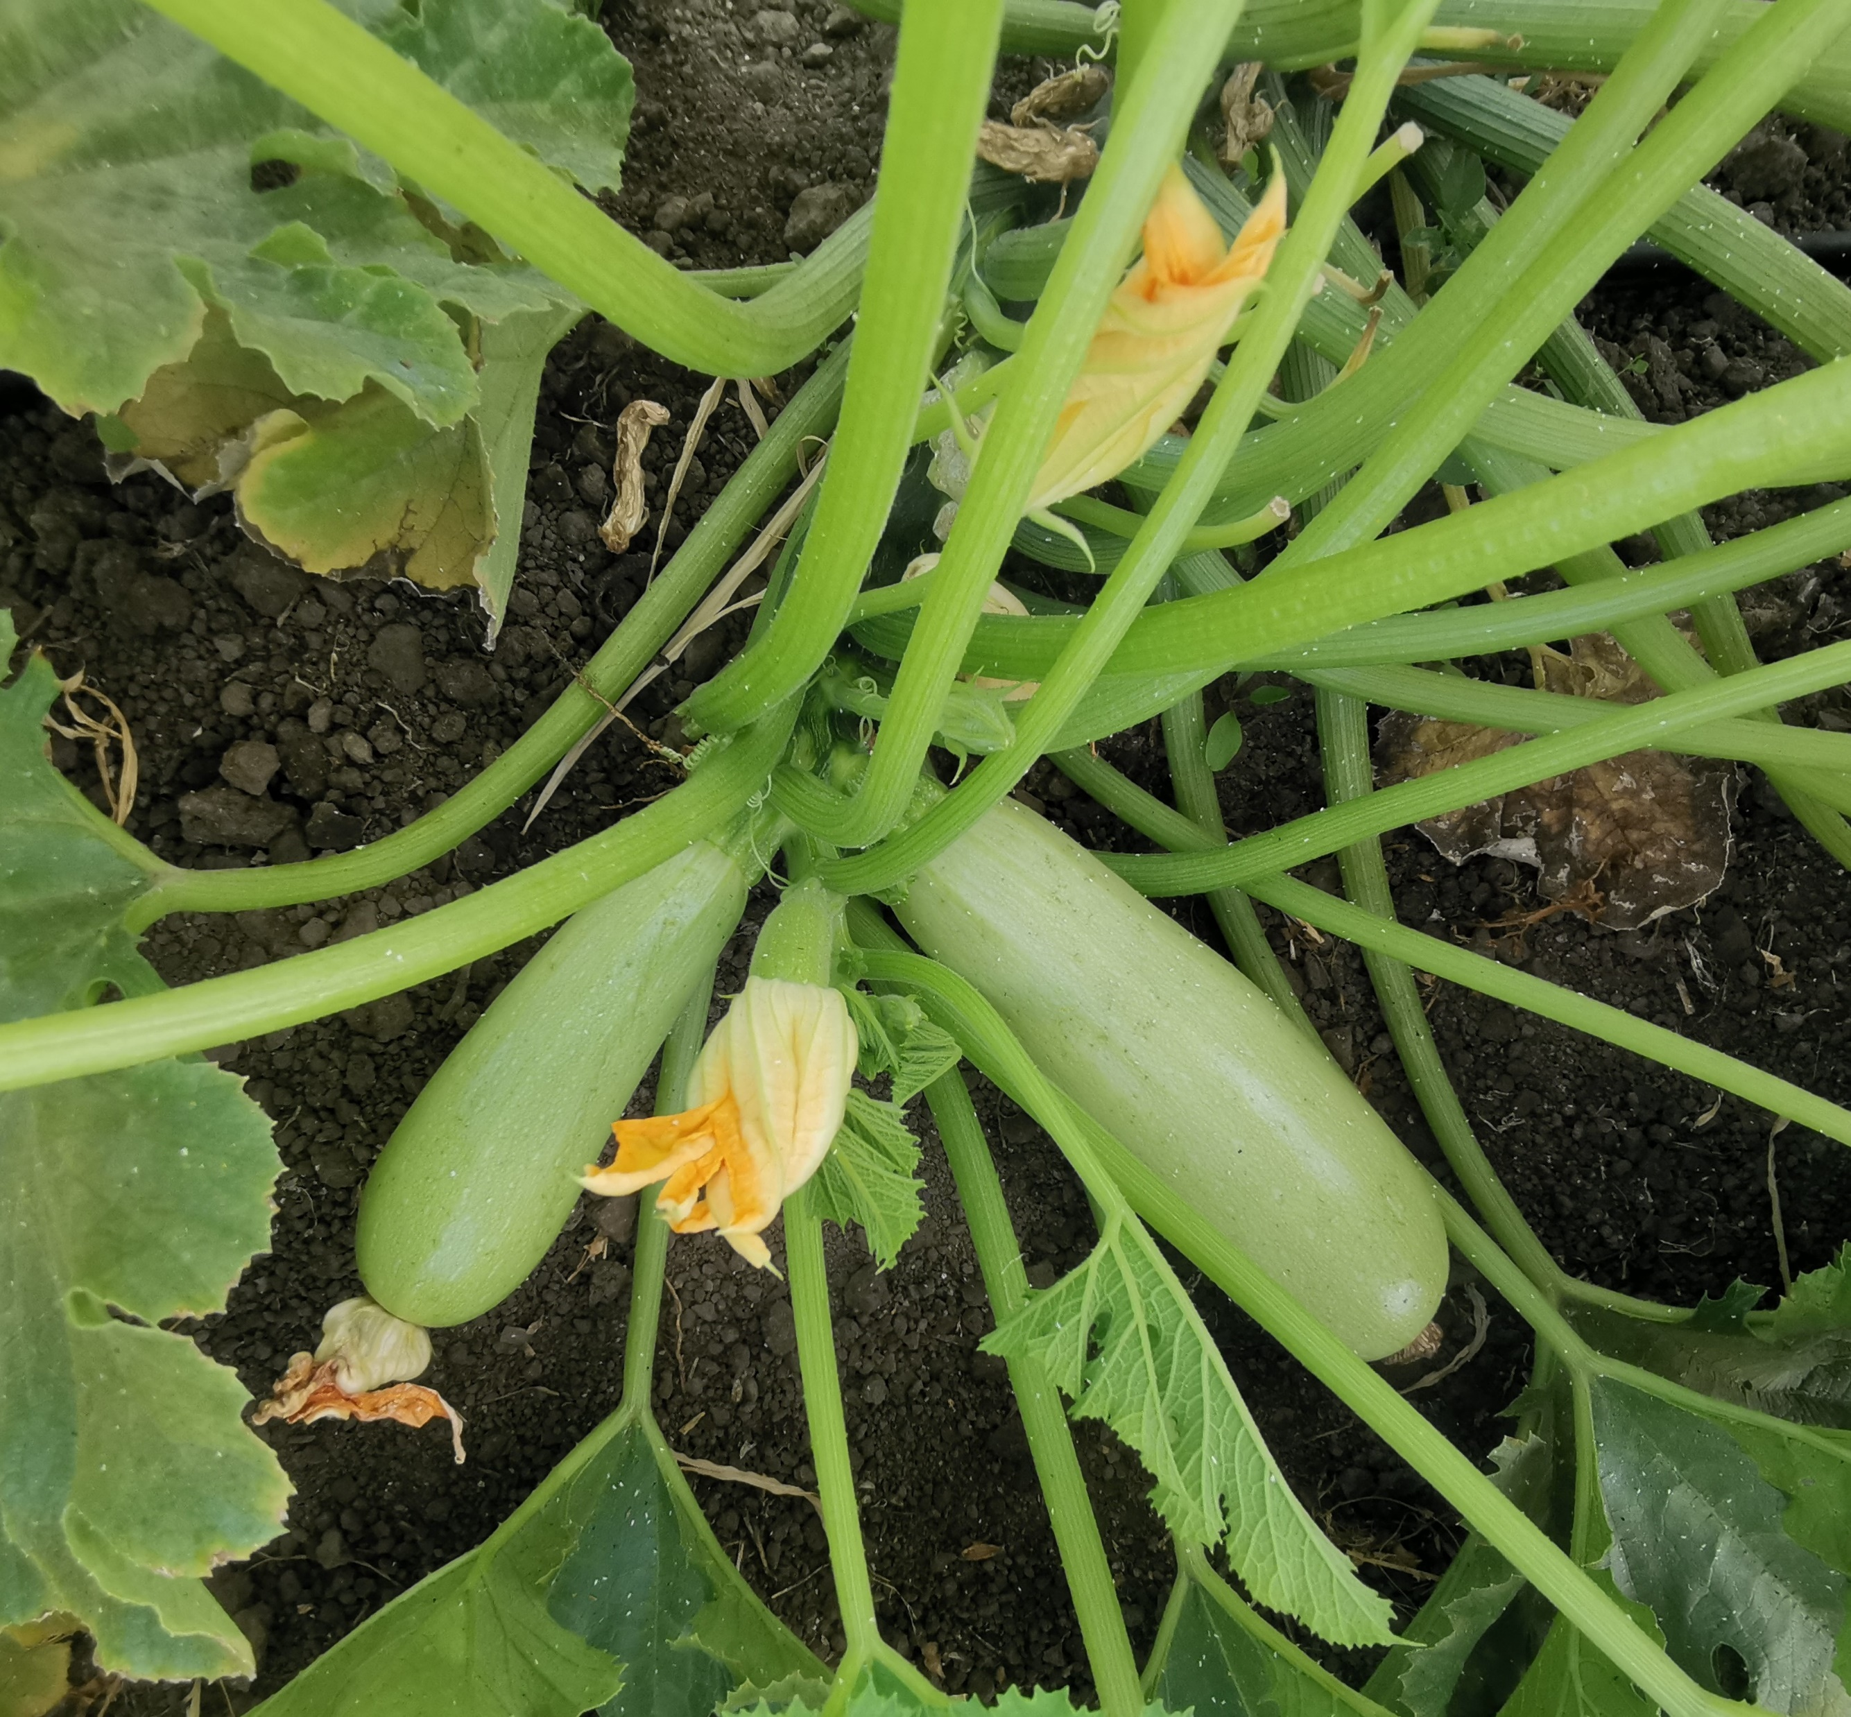
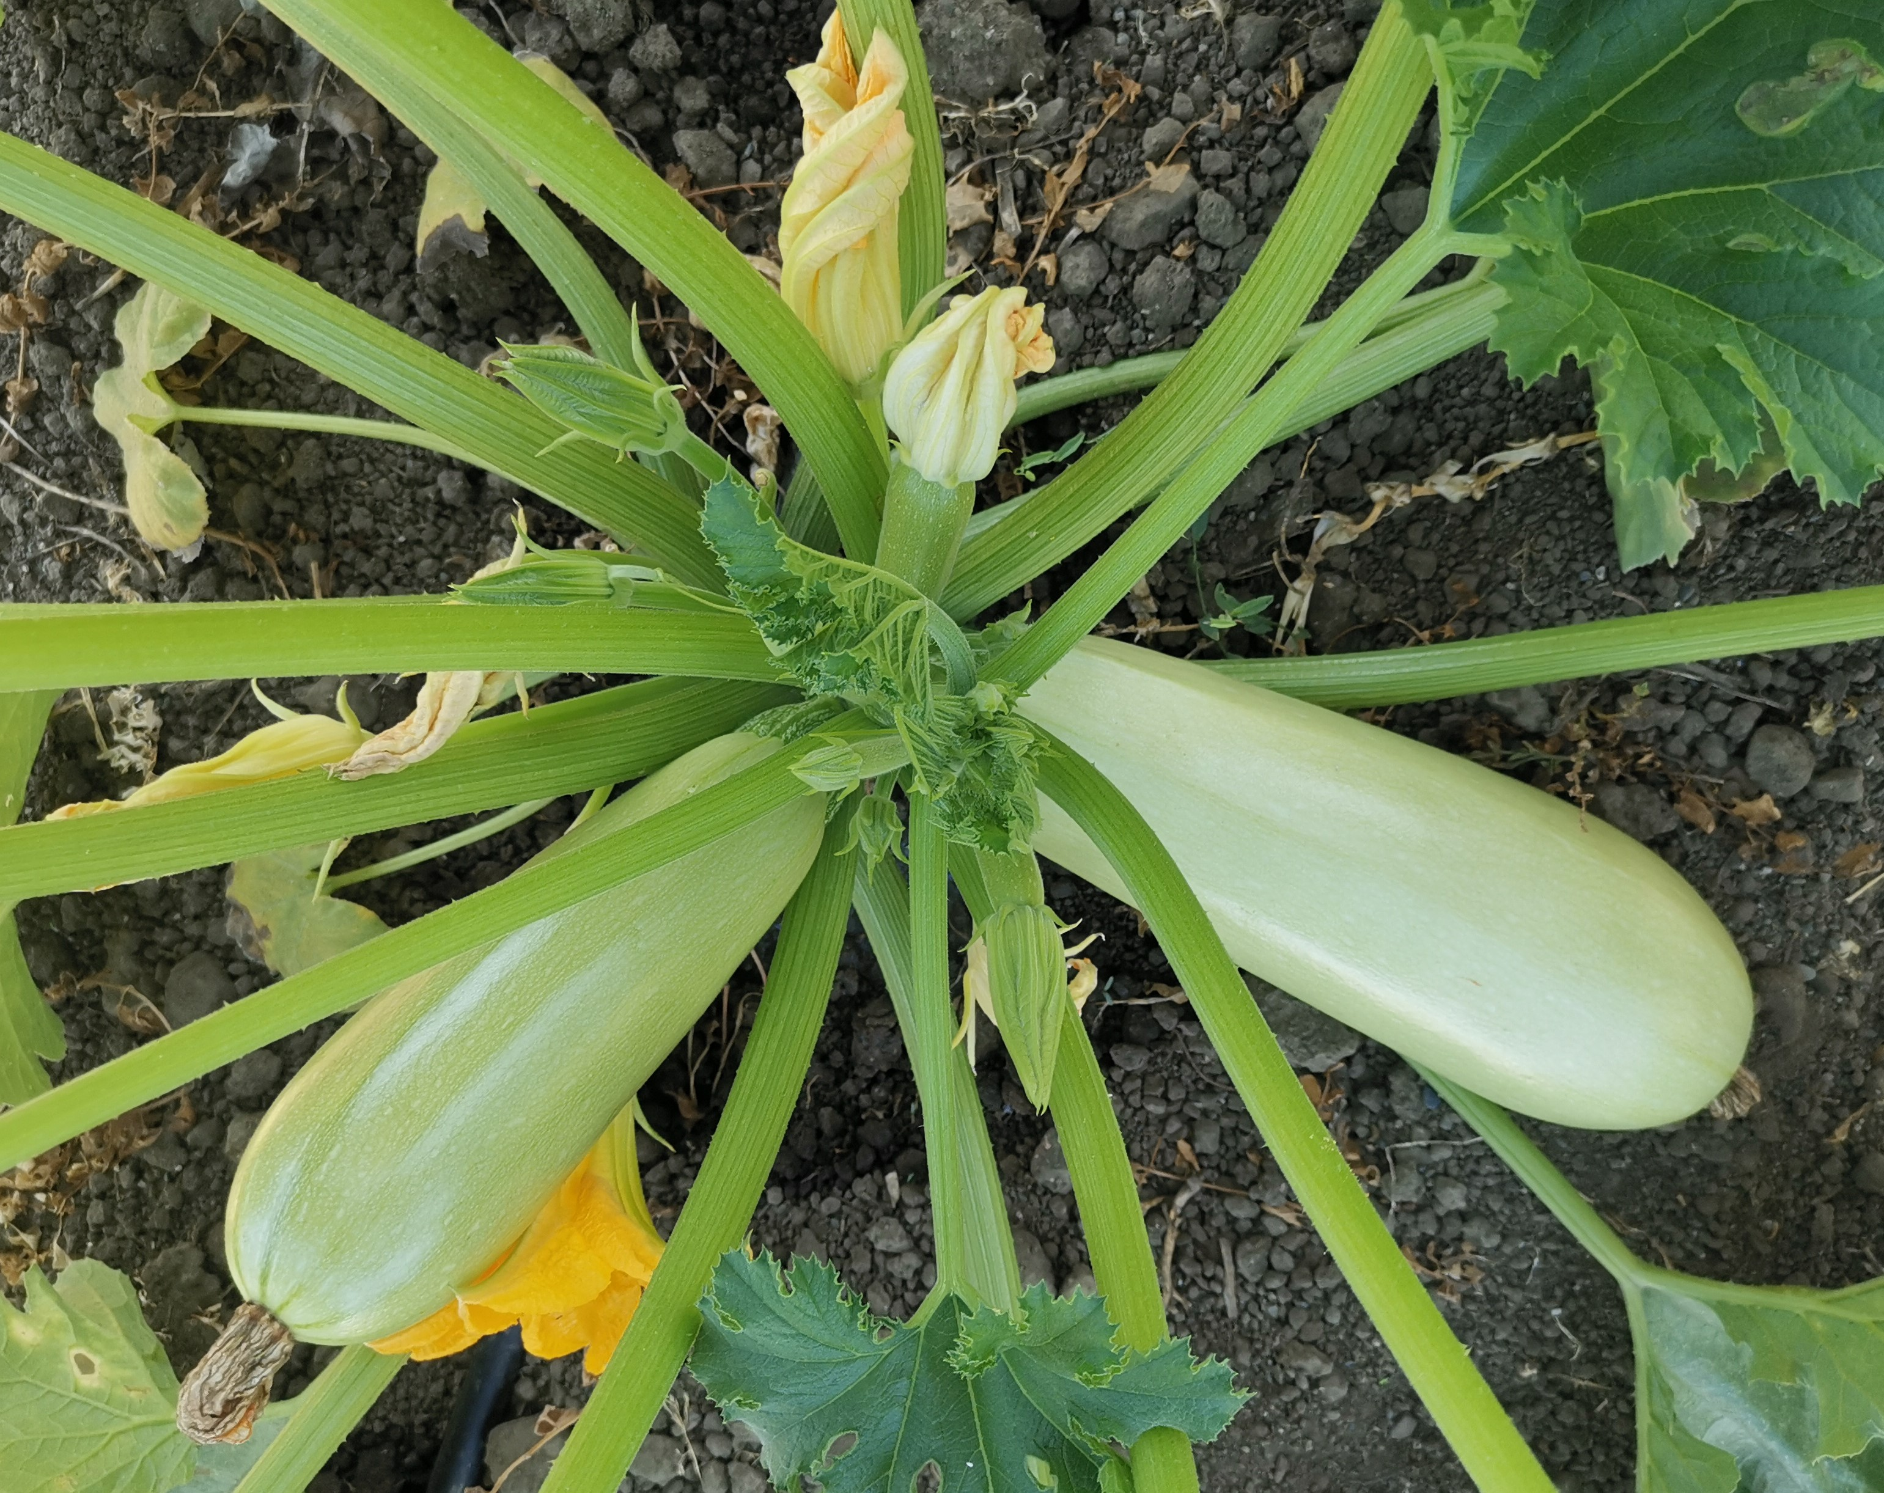
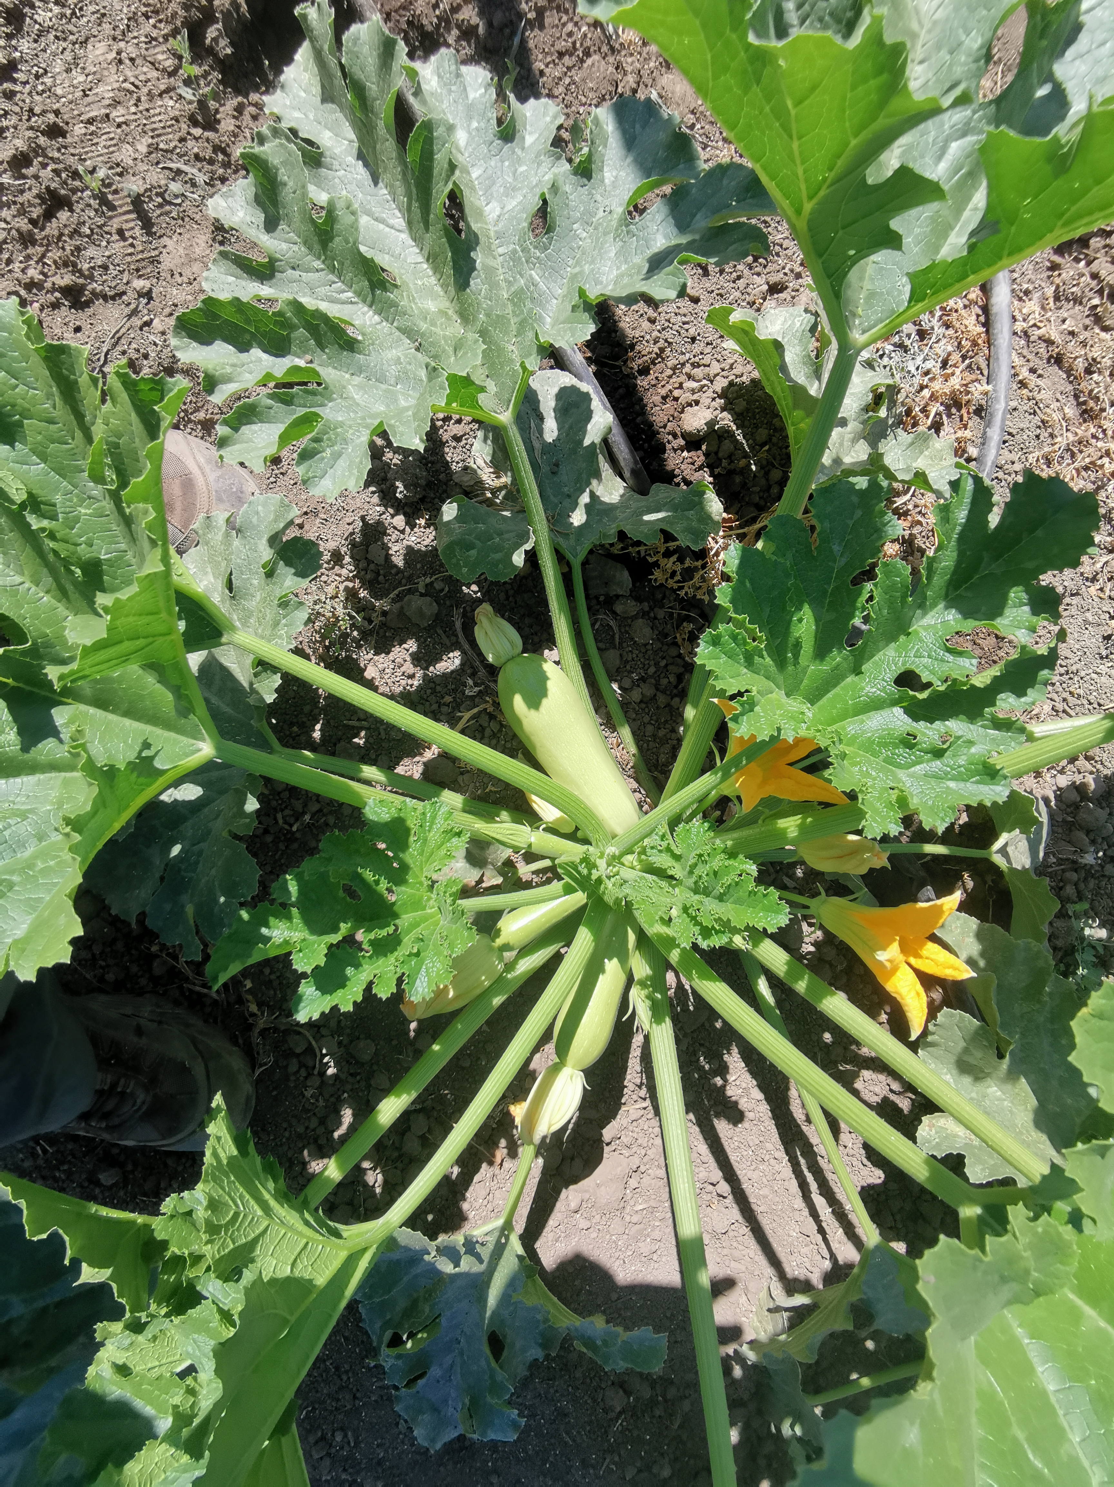
2021 #437 AQ7083=XQ2104 Green Z
Maturity | Plant uniform | Plant vigor | Plant size | Plant color | Open-ness | Spine | Inter-node | F setting | F shape | F color | Spots | Viral | PM | F/P | >average % | Remarks | Decision
Early | 5 | 5 | 5 semi-indetermiated | DG | O | M | S | 5 | Long bulby | Light green | No,very bright | 0 | 0 | 12.0 | 9.1% | Strong indetermied plant, excellent setting, high yield, uniform shinny fruits with no spots. For GH and open fields. | Commercial

